Slide 1
Search Space
Key Questions to consider:
How do we represent our game environment?
How do we find a path through it?
What happens when the game space is very big?

Slide 2
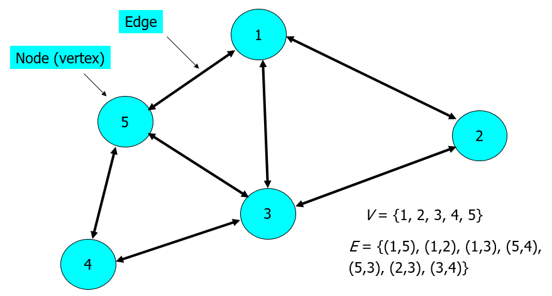
Search - Recap
Consider the graph opposite
Start Node is 1
  Where we start from
Goal Node is 4
  Where we want to get to

Slide 3
Search Tree
Search Tree contains:
  Root Node
  Parent Node
  Child Node
  Leaf Node
  Partial Path(s)
  Full Path(s)
A
B
D
C
D
C
E
D
E
C
E
F
E
F
E
F
F
F
F

Slide 4
Search Space
Branching Factor
  Number of moves available from each node
Search Depth
  Number of moves ahead we search from start position
Branching Factor of B and Depth of D means D^{B} possible paths
  Exponential!

Slide 5
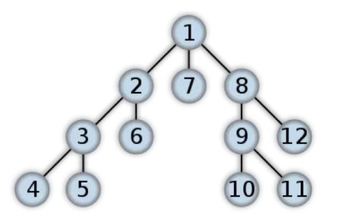
Depth First Search
DF-Search will, when choosing among alternative paths, choose the deepest one first
  Deepest means furthest from root

Slide 6
Depth First Algorithm
depthFirst(n)
processNode(n)
mark(n)
for every child c of n
if notMarked(c)
depthFirst(c)
end if
end for
end function

Slide 7
Depth First Algorithm
Queue PathList = new queue
Path P = new Path(StartNode)
  PathList.Add(P)
While (NOT(PathList.isEmpty)):
  Path Current = PathList.dequeue()
  Node EndNode = First(Current)
  markNode(EndNode)
  If (EndNode == Goal) then Exit Loop
  Else
    NodeList nextNodes = genSuccessors(EndNode)
    ForEach node in nextNodes:
      If notMarked(node):
      markNode(node)
        PathList.enqueue(node)

Slide 8
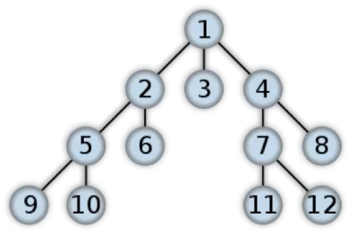
Breath First Search
Checks all paths of a given length before moving on to paths of longer length
Algorithm differs from depth first only in insertion of new paths to the BACK of the queue!

Slide 9
Breath First Algorithm
  Queue PathList = new queue
  Path P = new Path(StartNode)
  PathList.Add(P)
  While (NOT(PathList.isEmpty)):
  Path Current = PathList.dequeue()
  Node EndNode = First(Current)
  markNode(EndNode)
  If (EndNode == Goal) then Exit Loop
  Else
  NodeList nextNodes = genSuccessors(EndNode)
  ForEach node in nextNodes:
  If notMarked(node):
  markNode(node)
  PathList.AddToBack(node)

Slide 10
Which is best?
If we are confident that all partial paths either reach dead ends or become complete after a reasonable number of steps
  Depth First
If paths are long or even infinite
  NOT Depth First
If all paths lead to goal at the same depth
  Breath First
Large Branching Factor
  NOT Breath First
Some use cases
GPS Navigation: BFS
Peer-to-peer Computer Networks: BFS
Facebook connections: BFS
Single solution problems e.g. Mazes: DFS
Communication/Transportation networks (search strongly connected components): DFS

Slide 11
Non Deterministic Search
“Video games provide a new level of challenge when it comes to thinking about the sort of strategic behaviours where search has worked so well in board and card games. Principally this challenge is that the complexity of the naïvely defined state-action graph has both a branching factor and a depth that is orders of magnitude greater than that for even the most complex board games (e.g. Go), since we must make sometimes complex decisions (such as choice of animation and path) for a large number of agents at a rate of anything up to 60 times per second”
“Search in Real-Time Video Games”, Cowling et al, 2013, Artificial and Computational Intelligence in Games. Dagstuhl Follow-Ups, Volume 6.

Slide 12
Non Deterministic Search
When the details of the search space are largely unknown to us
  Unknown branching factor
  Possibility exists of traversing long useless paths
Then to strike a middle ground between depth first and breath first we can try non deterministic search
Next path to expand is chosen at random
Algorithm is exactly the same EXCEPT new paths are inserted into random locations in queue structure

Slide 13
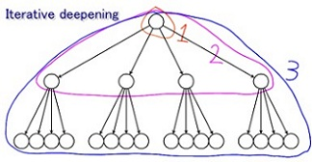
Iterative Deepening
Use depth first to find all paths up to some maximum length
While solution is not found and we have time left increment maximum path length
Repeat depth first to new path length
Used for time bounded search
  e.g. Chess

Slide 14
Bi-directional Search
If we know what the goal node is then we can do breath first search in both directions
  Search from start node
  Search from Goal node
Stop the search when we meet in the middle!
  But will we meet?
How about DFS in one direction and BFS in the other?
  Overhead of checking the intersection.

Slide 15
Comparison
 | TIME | SPACE | SHORTEST SOLUTION?
Breath First | B^{D} | B^{D} | Yes
Depth First | B^{Dmax} | Dmax | No
Iterative Deepening | B^{D} | D | Yes
Bi-directional | B^{D/2} | B^{D/2} | Yes
Check out: Minecraft Search video
Notes:
Thought this was interesting: https://www.youtube.com/watch?v=MyFIxvK-sxs

